Slide 1



Hardware and Software Fundamentals of
Intelligent Computing
Systems

Slide 2
Lecture 01: Course Introduction and AI Hardware Landscape

Slide 3


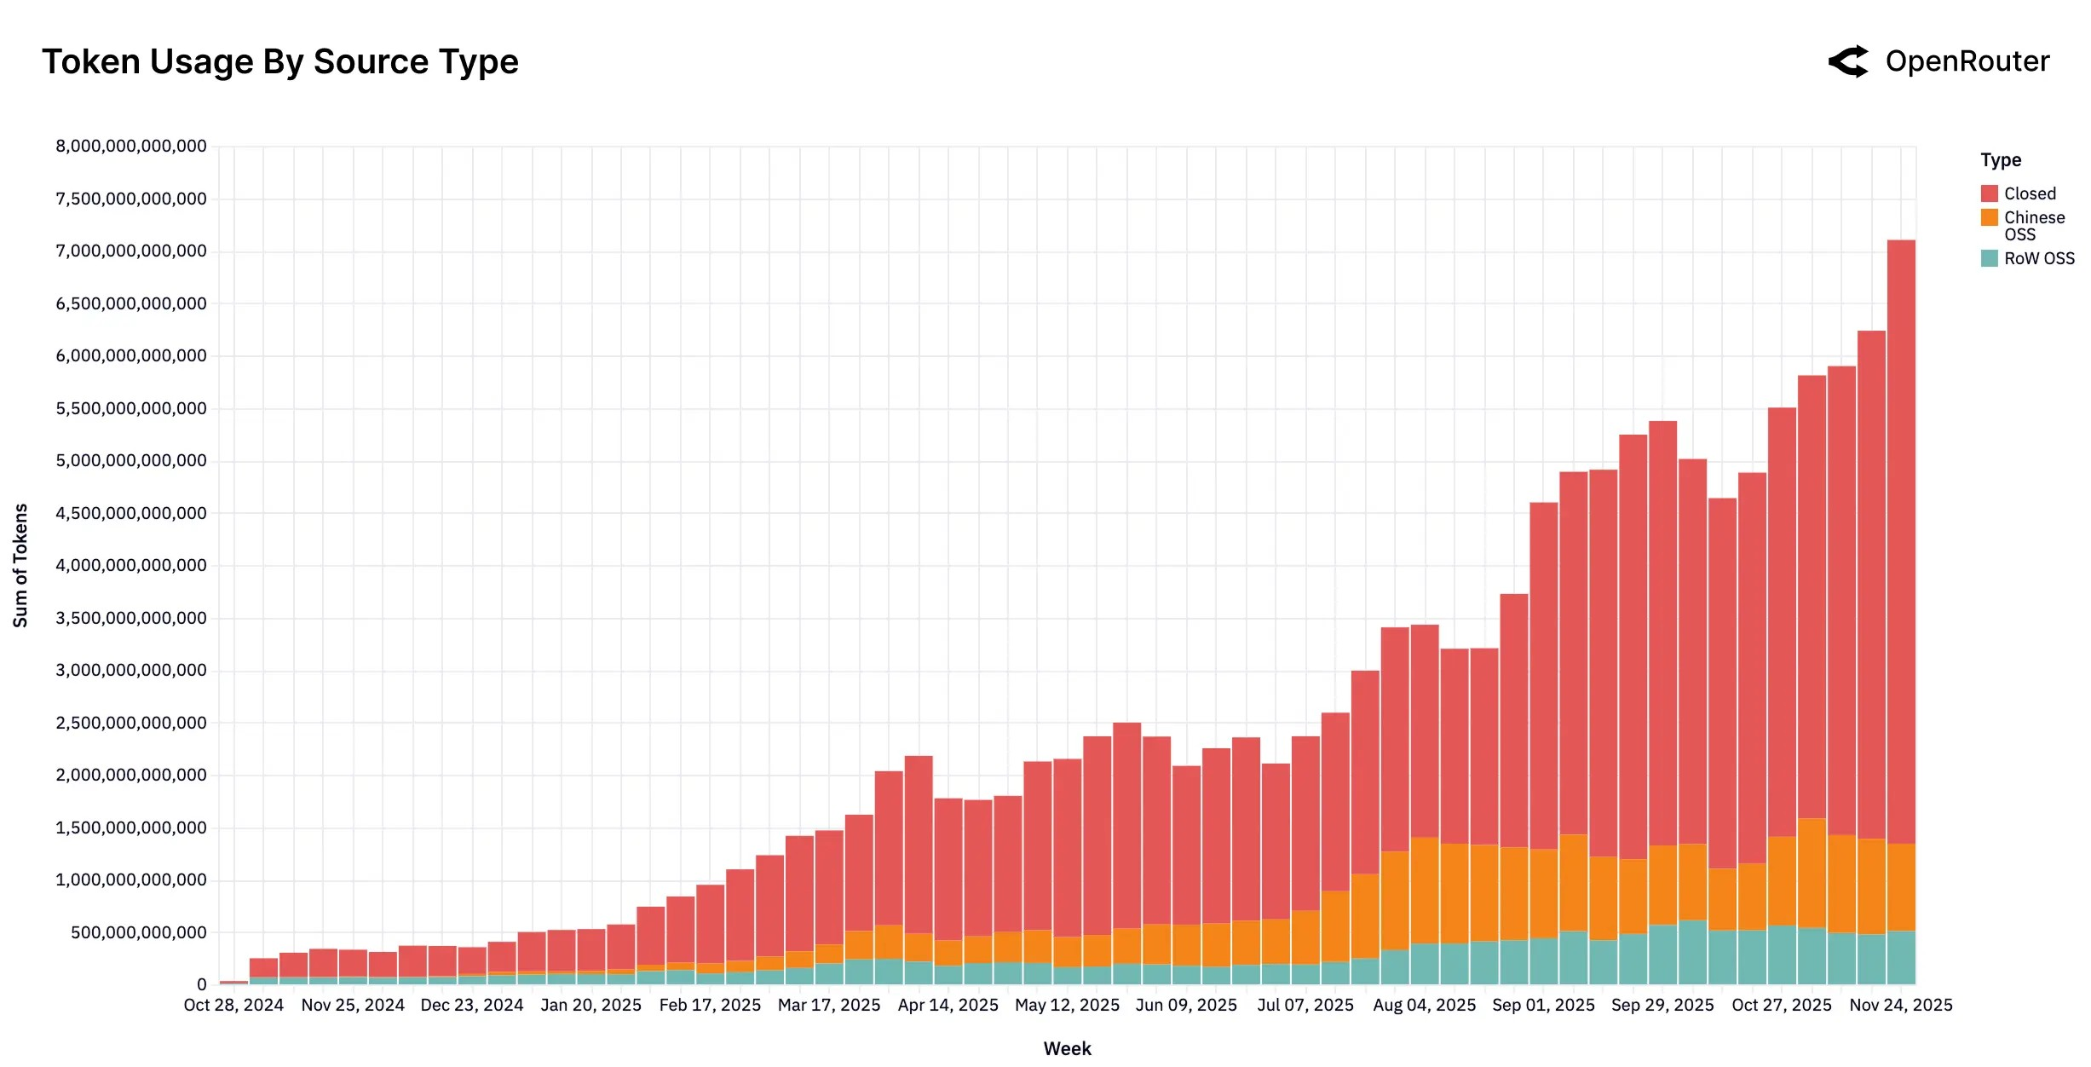

Token-Hungry Generative AI Applications
LLM-powered autonomous agents
Token consumption trends
AI mobile phone and AI PC
Video generation
Notes:
https://lilianweng.github.io/posts/2023-06-23-agent/
https://openrouter.ai/announcements/the-2025-state-of-ai-report
https://github.com/baaivision/URSA
https://eu.36kr.com/en/p/3576900266261385

Slide 4
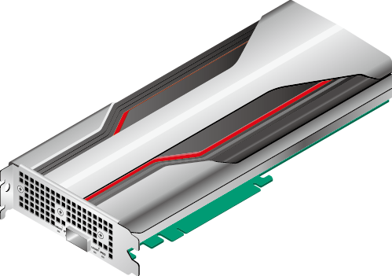
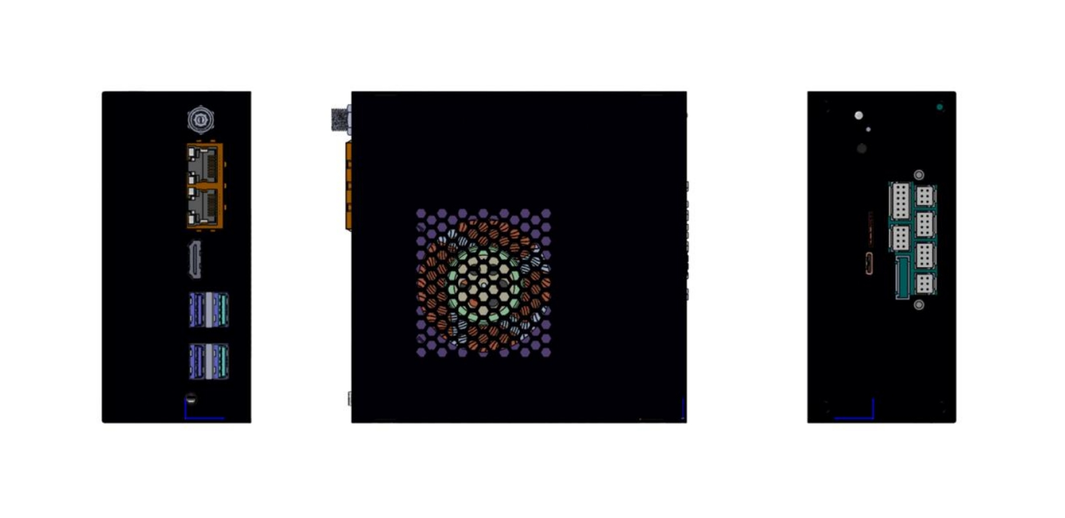
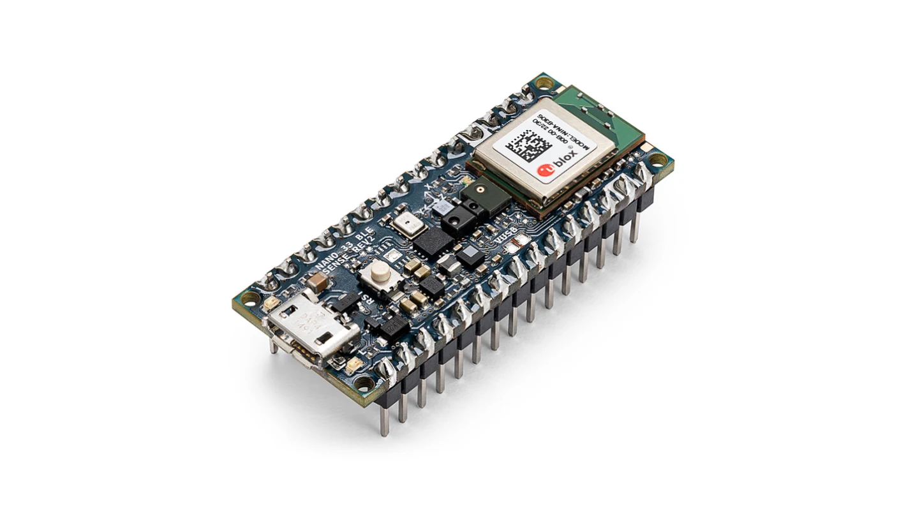

AI Hardware Spectrum: Key Examples
Cloud ML
Huawei Ascend
Cambricon MLU370
etc.
Edge ML
Iluvatar
TY1200
Mobile ML
Kirin 9030 Pro
Tiny ML
Arduino Nano 33
BLE Sense
Notes:
https://support.huawei.com/enterprise/zh/doc/EDOC1100162135/74b99d28
https://consumer.huawei.com/cn/phones/mate-x7/

Slide 5
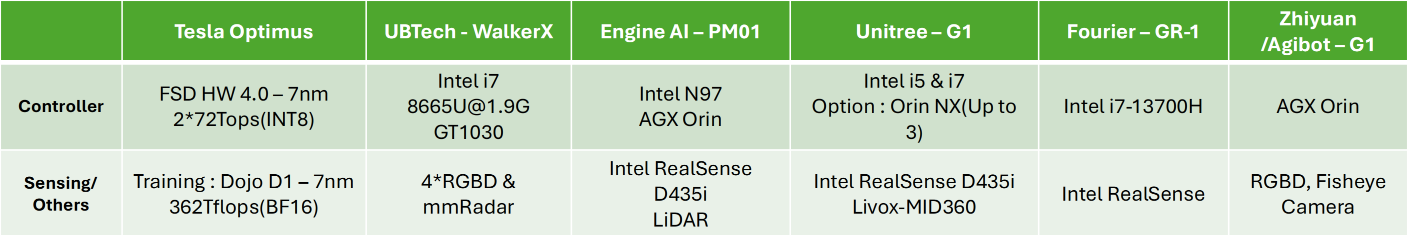

Slide 6
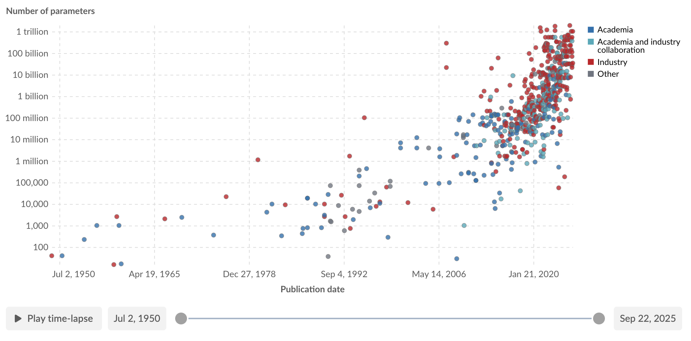
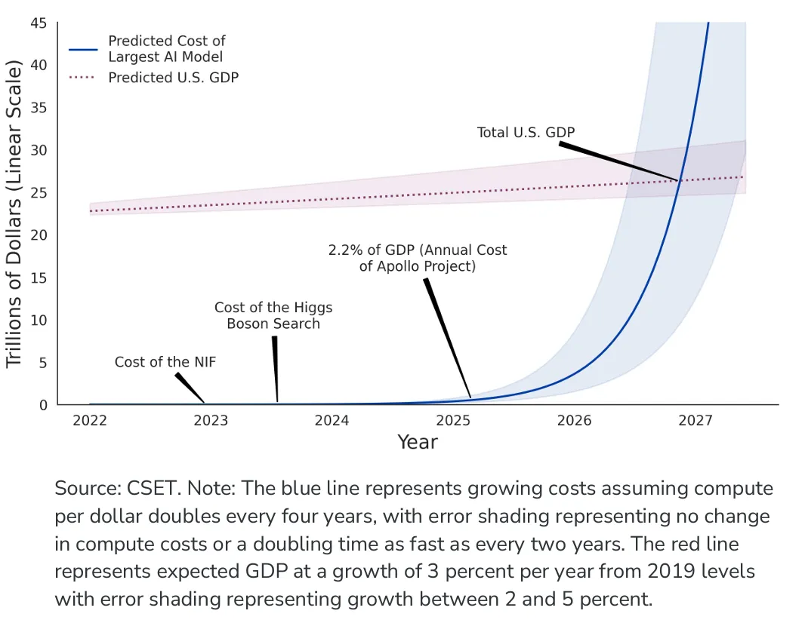
The Hardware Demands of AI/ML
Model Parameters
  The exponential growth.
Computational Demand
  Outpacing the Moore's Law.
  Comparison between compute cost and U.S GDP byOpenAI.
Communication Scale
  The new critical bottleneck.

Slide 7
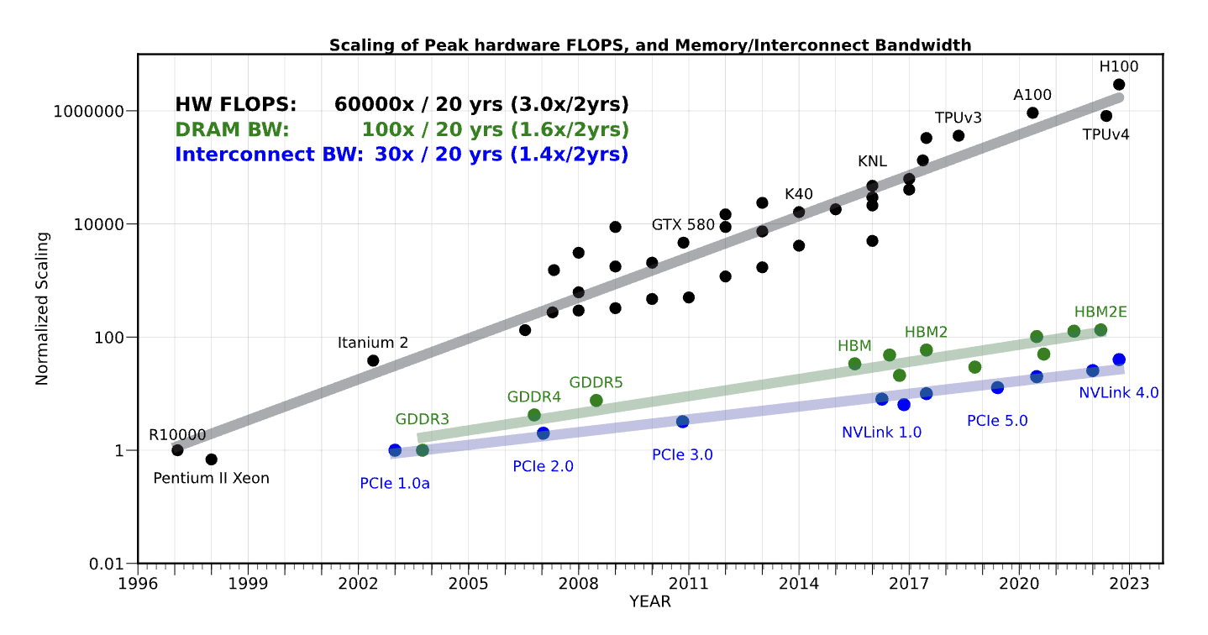
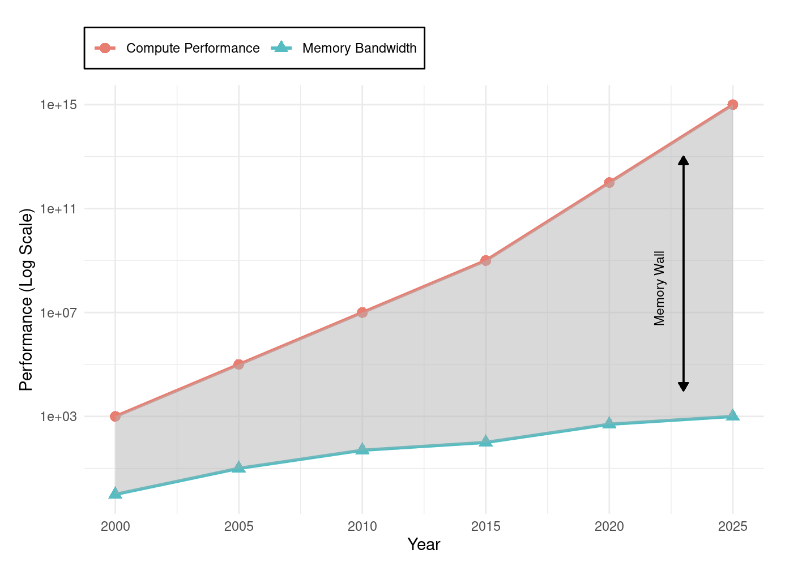
Why General-Purpose CPUs Failed AI (1/2)
The CPU's Legacy:
  For decades, the Central Processing Unit (CPU) was the universal engine of computing, designed for sequential, general-purpose tasks.
The Two Crises:
  Von Neumann Bottleneck: Constant data shuffling between processing and memory units created a fundamental efficiency limit, consuming more energy than the actual computation.
  End of Performance Scaling: Dennard Scaling and the derived performance effects from Moore’s Law, which provided decades of exponential performance growth, came to an end.
Notes:
找权威的数据或者来源

Slide 8
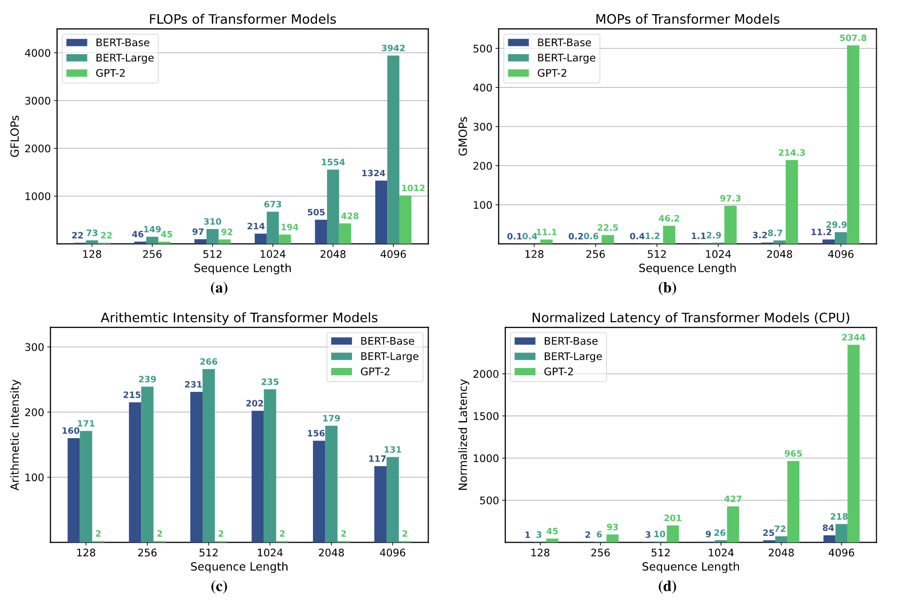
Why General-Purpose CPUs Failed AI (2/2)
The Mismatch:
  CPUs' sequential design is fundamentally inefficient for the massive parallelism inherent in AI workloads like matrix multiplication.
  CPUs achieve only 5-10% utilization on neural network workloads, delivering approximately 100 GFLOPS10 while consuming hundreds of watts*.
Conclusion:
  AI's exponential demands exposed the limits of the general-purpose model, forcing a shift to specialized hardware.
Notes:
找权威的数据或者来源

Slide 9
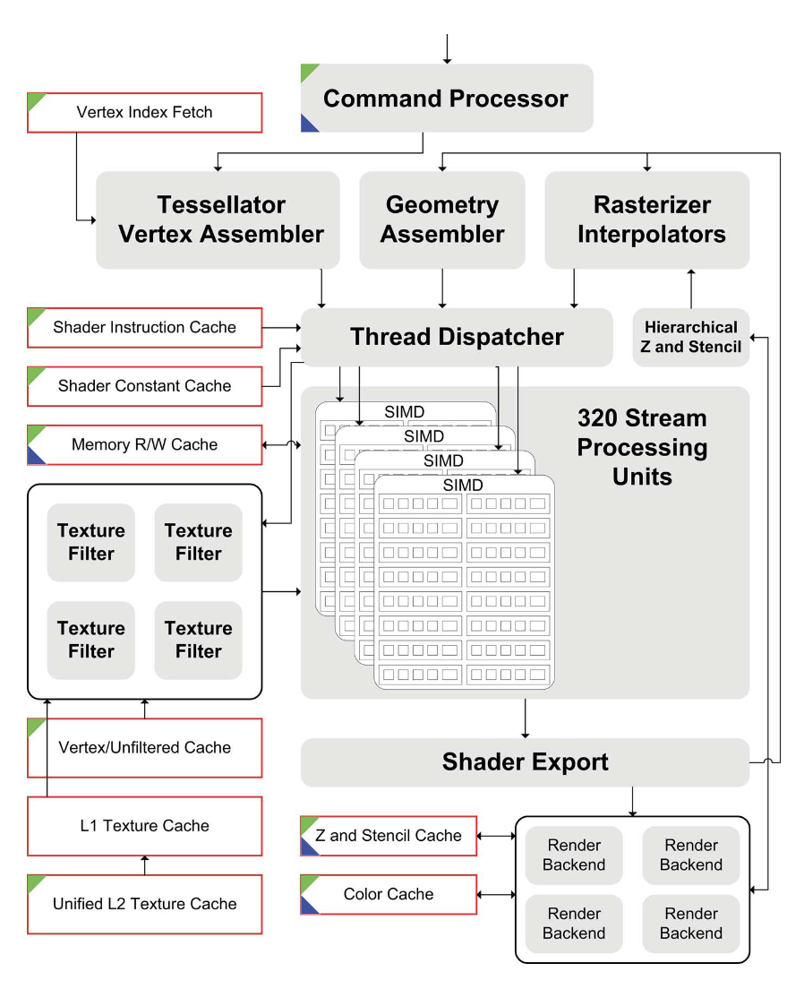
The Rise of the GPU
An Unlikely Hero: The Graphics Processing Unit (GPU) was born in the late 1990s for video game graphics, featuring thousands of simple cores for parallel tasks.
Architectural Resonance: The core math of graphics (matrix and vector operations) was identical to the math of deep learning, making GPUs a perfect, albeit accidental, fit.

Slide 10
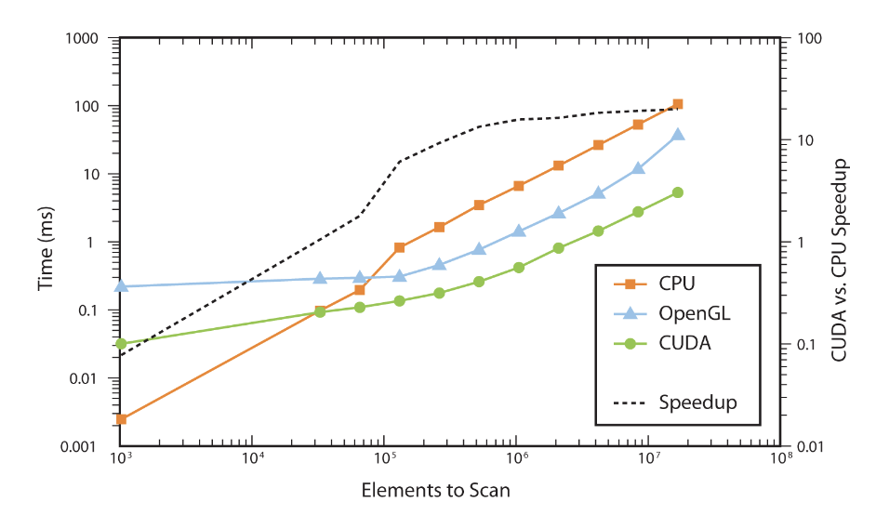
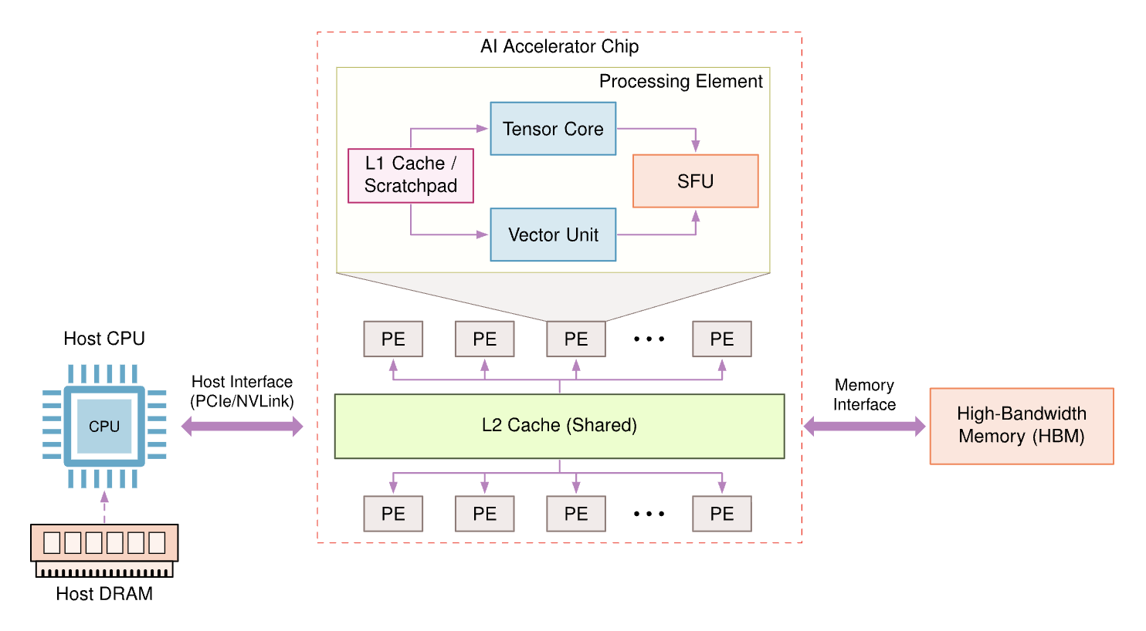
The Rise of the GPU
The Software Catalyst: CUDA: NVIDIA's CUDA platform (2007) unlocked the GPU for general-purpose computing, making its power accessible to AI researchers without deep graphics expertise.
The Result: Training times for AI models plummeted from weeks to hours, establishing the GPU as the de facto standard for AI training.

Slide 11
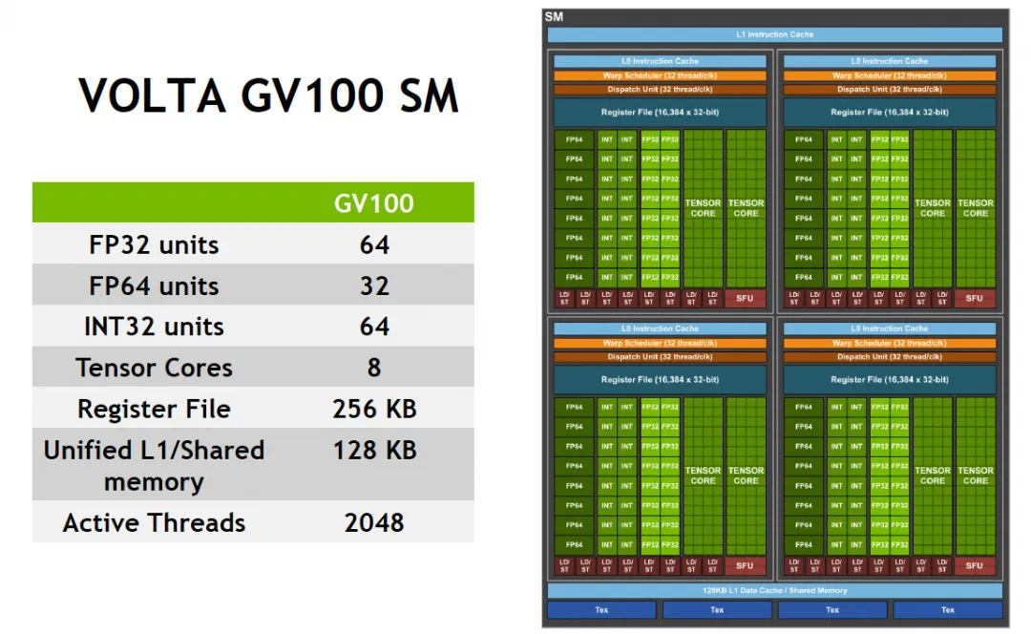
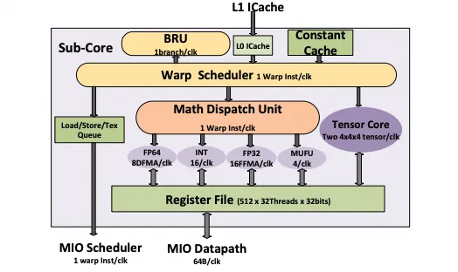
1st-Gen Tensor Core: Warp-scoped MMA

Slide 12
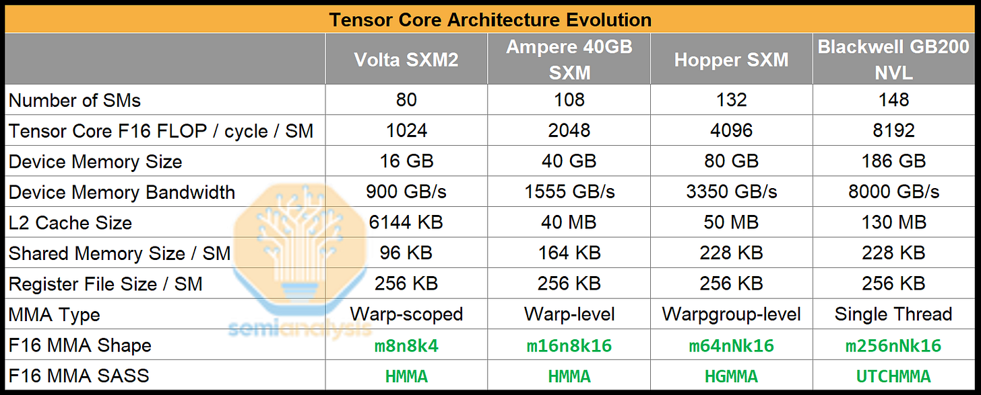
Scaling of Tensor Cores in NIVIDIA GPUs (1/3)

Slide 13
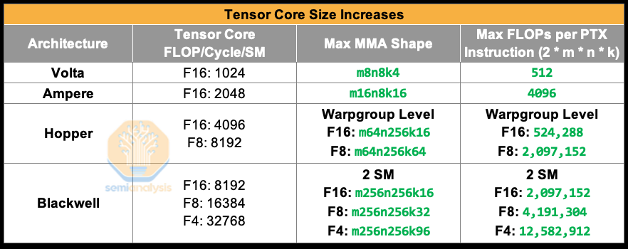
Scaling of Tensor Cores in NIVIDIA GPUs (2/3)

Slide 14
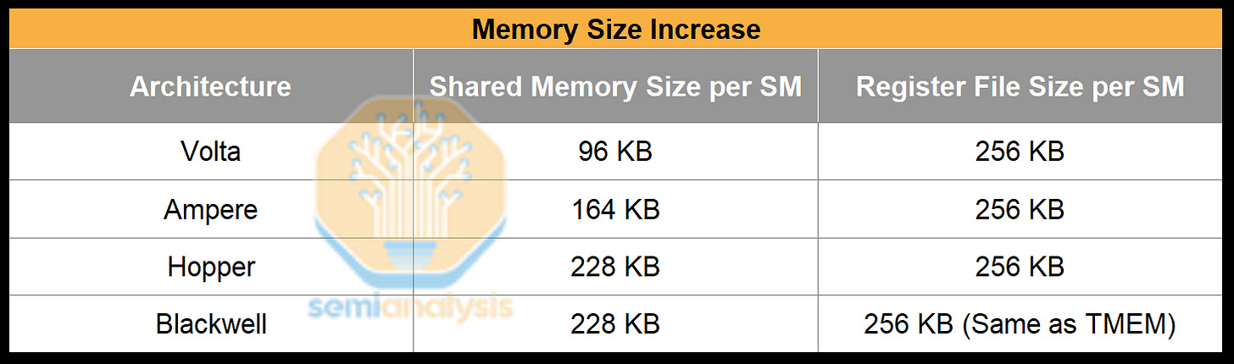
Scaling of Tensor Cores in NIVIDIA GPUs (3/3)
Tensor Core throughput doubled every generation, but global memory load latency didn’t decrease and in fact increased. As a result, we need to increase the staging SMEM size for buffering more data

Slide 15
Compute Architectures Evolve
GPU series (+ Tensor cores)
TPU series
Ascend series
CPU series: Intel (+ matrix extension); AMD (+ NPU)
compute-in-memory
wafer-scale chip
Supernode and Hypercomputer
...

Slide 16
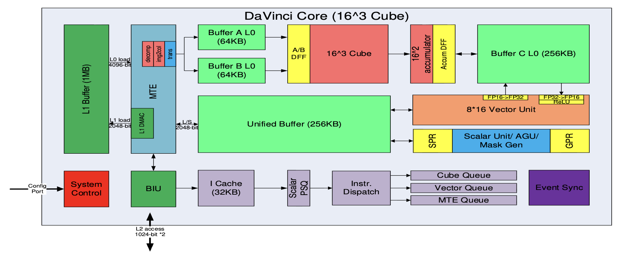
Huawei DaVinci Architecture
Cube：4096(16^3) FP16 MACs + 8192 INT8 MACs
Vector：2048bit INT8/FP16/FP32 vector with special functions（activation functions, NMS- Non Minimum Suppression, ROI, SORT）
Explicit memory hierarchy design, managed by MTE
Notes:
详细讲一些

Slide 17
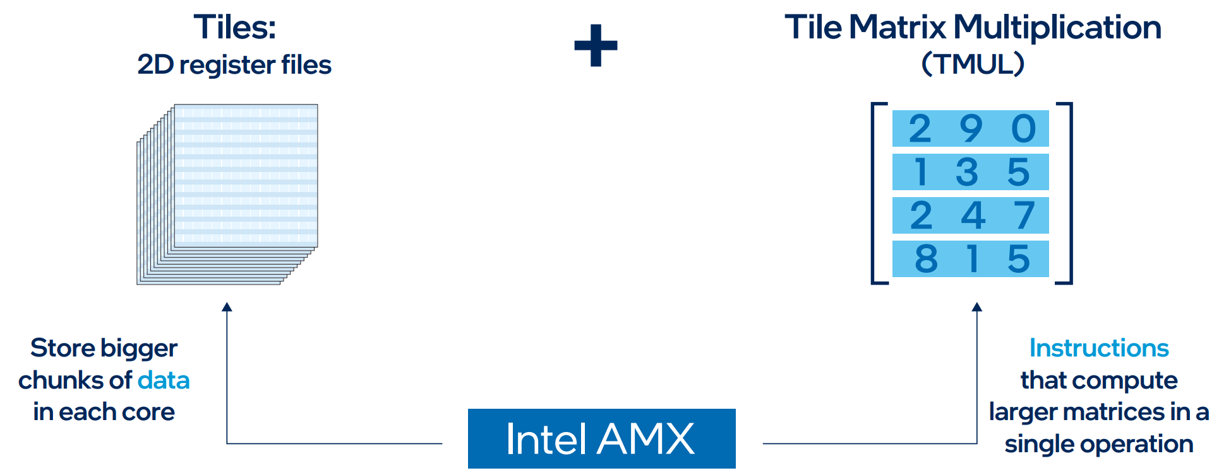
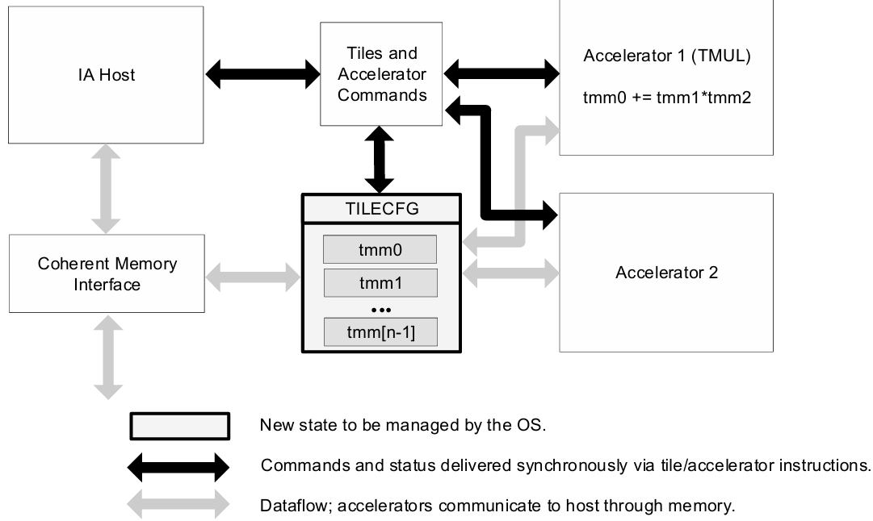
Intel’s Advanced Matrix Extensions (AMX)
Strategy: Enhance CPU with AI acceleration capabilities.
Architecture: An extension to the x86 ISA, not a separate chip.
Core Components:
  Tiles: 2D register files
  TMUL: dedicated matrix multiply instruction
  Explicit load/store/configuration model
  Instructions: tilecfg, tileload, tmul, tilestore
  Initial support: INT8, BF16 (extensions for FP16)

Slide 18
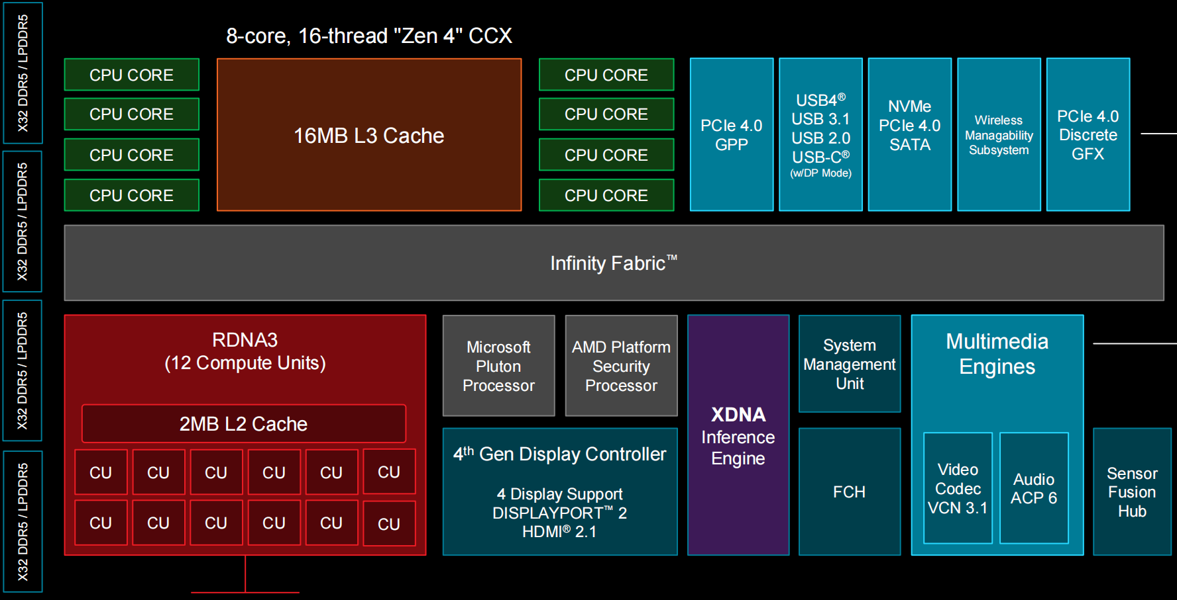
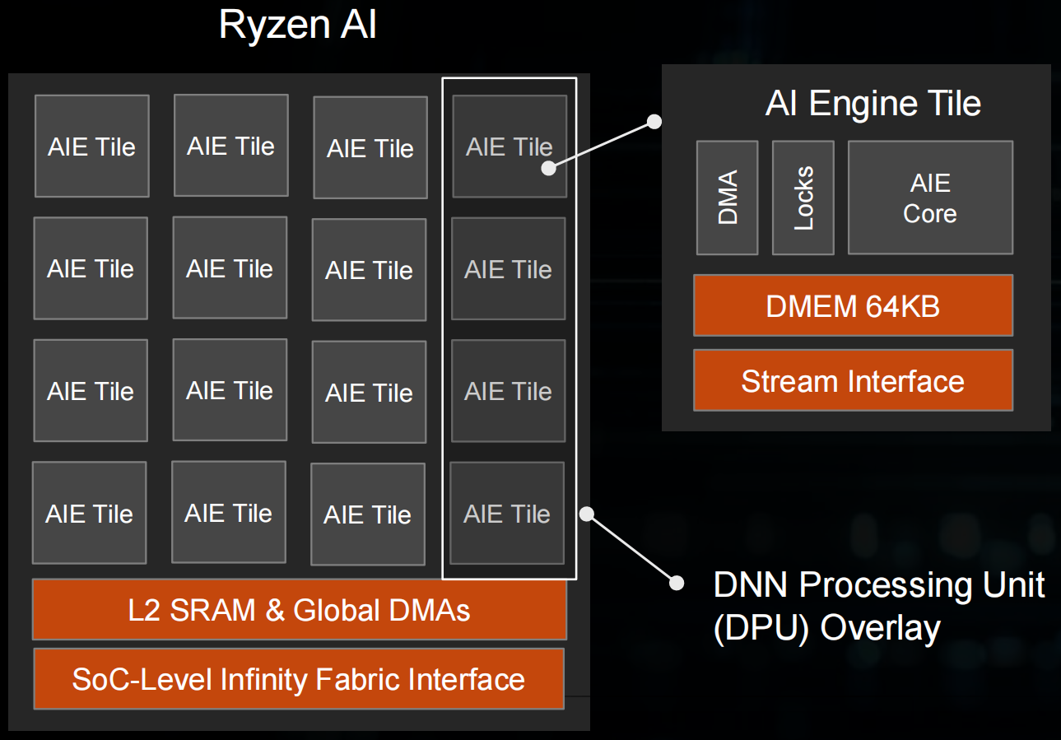
AMD Zen + RDNA + XDNA SoC
XDNA

Slide 19
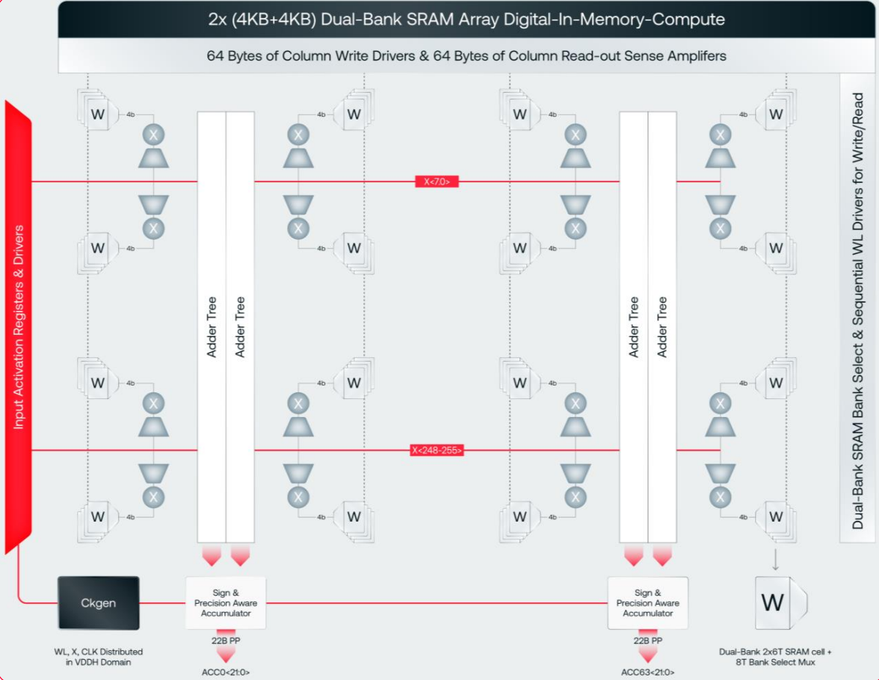

Digital IMC Architecture (d-Matrix)
Compute: Digital IMC (DIMC)
  Zero Data Movement: Logic units integrated within SRAM to eliminate transfer overhead.
  Digital Precision: Supports MXINT8/MXINT4 block-floating-point formats.
  Efficiency: 38 TOPS/W (vs. ~2.8 TOPS/W for H100).
Storage: SRAM & Memory Hierarchy
  Stash (Weights): 6MB/slice; 150 TB/s aggregate bandwidth.
  Global Memory (Activations): 4MB/slice.
  LPDDR5 (256GB): For massive models and KV Cache.
Scalability & Software
  Scale-Out: Transparent interconnect bypassing RDMA.
  Host-Free Runtime: RISC-V cores manage graph execution, eliminating Host CPU bottlenecks.

Slide 20
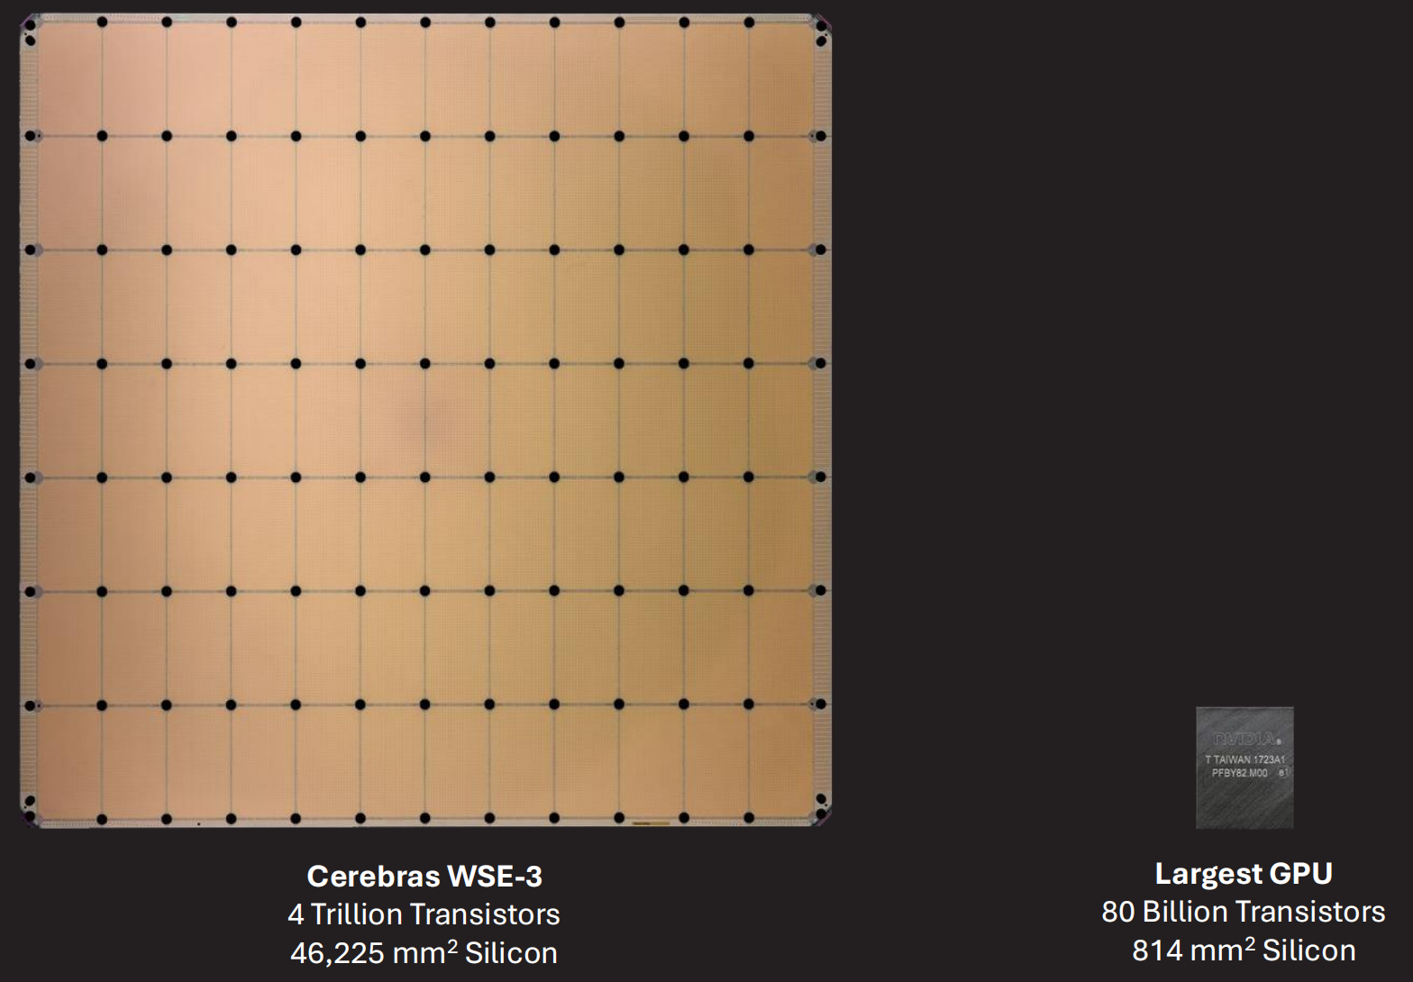

Wafer-Scale Architecture (Cerebras)
WSE-3 Specs (vs. NVIDIA H100)
  Die Area: 46,225 mm² (57x，↘)
  AI Cores: 900,000 AI cores (52x，↘)
  on-chip Memory: 44 GB SRAM (880x)
  Memory Bandwidth: 21 PB/s (7000x)
WSE-3 Core Architecture
  Co-located Compute & Memory: Logic and storage are tightly coupled to minimize latency.
  High-Performance AI Compute: 8/16-way SIMD supporting 16-bit/8-bit data formats.
  High-Bandwidth Storage: Massive local SRAM and specialized cache hierarchies.
Inference Strategy: On-Chip Pipeline Parallelism
  Physical Mapping: Model layers are mapped across different wafer regions.
  Near-Zero Latency: Communication happens via a high-speed Silicon Interconnect, effectively eliminating traditional networking overhead.

Slide 21


Supernode Architecture (NVL72 & CloudMatrix 384)
NVIDIA NVL72: "The Rack is the Chip"
  Chip-Centric, Compute-First Supernode: Designed as a unified computational entity.
  Architecture: 72 Blackwell GPUs integrated into a single rack, interconnected via a Copper Backplane (NVLink Switch).
  Objective: Emulate Wafer-Scale (WSI) performance using discrete components; leverages copper interconnects for rack-level All-to-All high bandwidth.
Huawei Cloud-Matrix 384
  System-Centric, Communication-First Unified Supernode: Prioritizes large-scale interconnect efficiency.
  Mechanism: Interconnects hundreds of Ascend processors via the proprietary HCCS protocol to build a Unified Memory Pool.
  General-Purpose Advantage: Unlike niche inference chips, it balances large-scale training and inference, backed by the mature CANN ecosystem.

Slide 22
Model Parameter vs GPU Memory Capacity
NLP Moore’s Law
  Model Params: >10,000× growth in 7 years
GPU Memory Growth
  Memory Capacity: <10× growth in 7 years
Time | Model | Size
2018 | BERT-Large | 0.34 B
2019 | GPT-2 | 1.5 B
2020 | GPT-3 | 175 B
2023 | GPT-4 | ≈1.8 T (MoE)
2024 | Llama-3.1 | 405 B
2024 | Gemini 1.5 Pro | ≈1.5 T
2024 | DeepSeek-V3 | 671 B (MoE)
2025 | GPT-4.5 | ≈12.8 T (MoE)
Time | GPU | Memory Capacity | Memory Bandwidth
2018 | V100 | 32 GB | 900 GB/s
2020 | A100 | 80 GB | 2.0 TB/s
2022 | A800 | 80 GB | 2.0 TB/s
2023 | H100 | 94 GB | 3.9 TB/s
2024 | H200 | 141 GB | 4.8 TB/s
2025 | B200 | 192 GB | 8 TB/s
2025 | B300 | 288 GB | 10 TB/s
Massive-scale, high-bandwidth interconnects are mandatory
Notes:
AI model timeline: https://lifearchitect.ai/timeline/

Slide 23
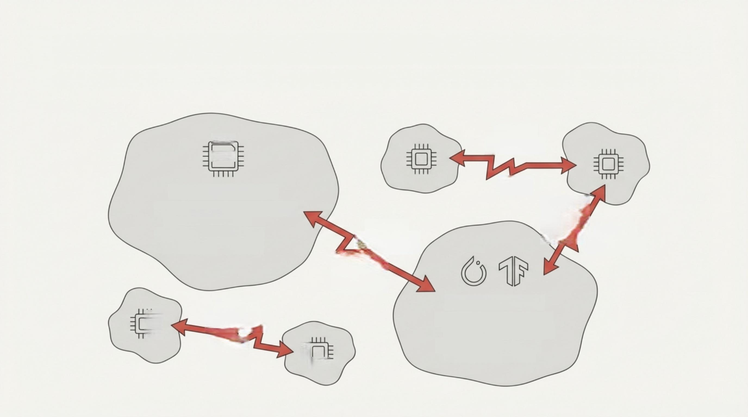
The AI Obstacle Course: The Challenge of a Multi-Chip World

Slide 24

The Solution: FlagOS, a Unified AI Software Stack

Slide 25








https://space.bilibili.com/3546791834290849
https://github.com/flagos-ai
https://www.zhihu.com/people/95-22-20-18/posts
https://flagos.io/Home

Slide 26

Thanks for your time！

